Slide 1
Design Thinking Workshop
SBNewcomers Club
November 18, 2025

Slide 2
Three Principles of Design Thinking
Human-centered design
Mindfulness of the process
Prototyping culture

Slide 3
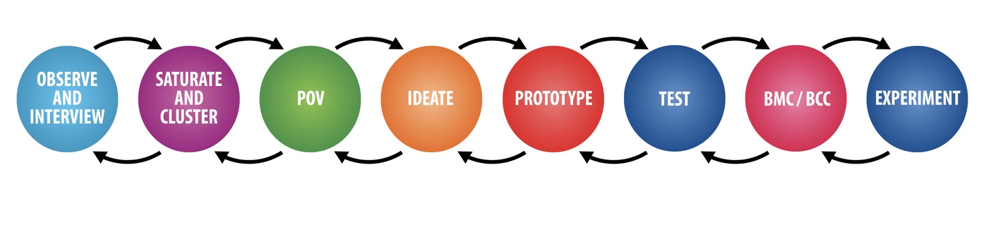
Key Steps in Design Thinking
Our Pre-work
Ed and AI
Tonight!

Slide 4
1. INTERVIEW
Open-ended questions to understand user wants and needs
  Walk me through your experience…
  What works well?
  What are the issues?
  Probe for stories and specific incidents.
  Ask “Tell me about the last time you ….”
  Listen for emotions and frustrations
  Don’t ask leading or binary questions.

Slide 5
2. SATURATE AND CLUSTER
  Empathy Map: Groups the insights in categories. Synthesizes your findings.
Quotes & Defining Words | Thoughts & Beliefs
Actions & Behaviors | Feelings & Emotions
Usability/Tactical Needs
Emotional/Aspirational Needs

Slide 6
3. POV (Point of View Statement)
  A point of view consists of two elements:
    a unique, empathic understanding of a user group
    an insight into a need those users share.
  This helps define the problem.
  “X needs a better way to do Y because of Z”

Slide 7
4. IDEATE
Brainstorm ideas on how to meet your user’s needs.
RULES of Brainstorming
  Defer judgment
  Go for quantity
  Encourage wild ideas
  Breakout ideas can be found right next to the absurd ones.
  Build on the ideas of others
  Be visual

Slide 8
5. PROTOTYPE
Create prototypes of the top ideas that you can show to the user and get feedback.
Low resolution sketches and diagrams work well. You don’t want to be too married to the ideas so that it’s hard to hear feedback.

Slide 9
6. TEST/ITERATE
Get feedback from the user and make changes based on feedback.
  What do they like/ dislike?
  Preferences?
Return to the previous steps(s) as you get more information.

Slide 10
Example of Design Thinking in Action
Problem: Premature babies were dying in rural India.
Request: Hospitals said “We need parts for old incubators””
Design Thinking proved otherwise.

Slide 11
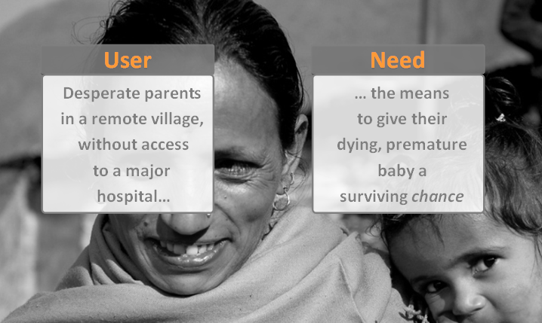
Point of View = User + Need

Slide 12

Interviews and Iteration Facilitated a Solution
Solution needed to work in villages without electricity
Initial prototypes were not well received
Final solution: Baby Warmer
  Includes unique pad with with a melting point of 98F.
  Stays warm for 8 hours

Slide 13

Success: embraceglobal.org
Has helped 1 million babies in 25+ countries
In use in today Gaza, Ukraine, and around the world.
Organization combines Non-profit with For-profit business models

Slide 14
Design Thinking is an Iterative Process

Slide 15
"Successful innovations take a moment of agony and turn it into a moment of delight.”
Saar Gur, Stanford Graduate School of Business

